Slide 1
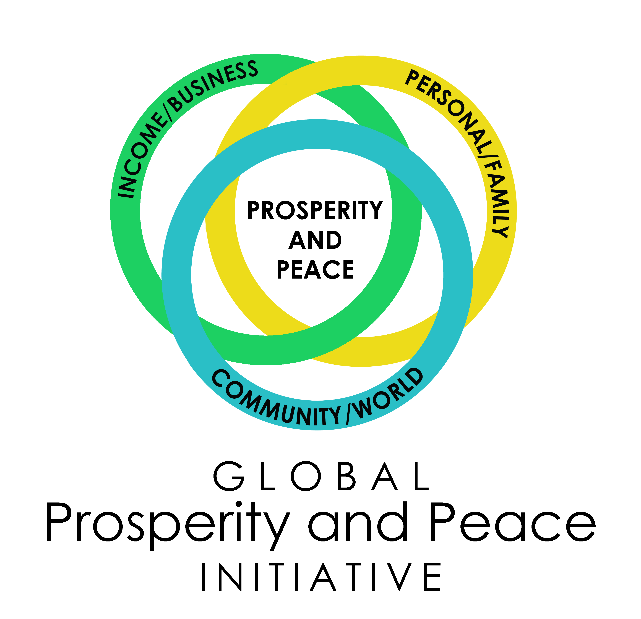
Peace is Possible
5 Powerful Action Steps
Written by Dr. Paula Fellingham
www.ProsperityandPeace.org

Slide 2
Our goal: “To increase the level of love and peace on Earth.”

Slide 3
5 Powerful Action Steps 1. Believe and Become 2. Shift and Shine 3. Eliminate Ego 4. Lighten Up and Love 5. Promote Peace

Slide 4
Action Step 1 Believe and Become

Slide 5
“The greatest discovery of my generation is that human beings can alter their lives by altering their beliefs.” - William James

Slide 6
“Believe you will succeed. Believe it firmly, and you will then do what is necessary to bring success about.” - Dale Carnegie

Slide 7
We must believe that our world can be a better place and we can be the change we wish to see in the world.

Slide 8
Peace begins in the heart – it’s taught in the home – and then it can spread throughout humanity.

Slide 9
Action Step 2 Shift and Shine

Slide 11
This shift is like a transformation of your heart and soul.

Slide 12
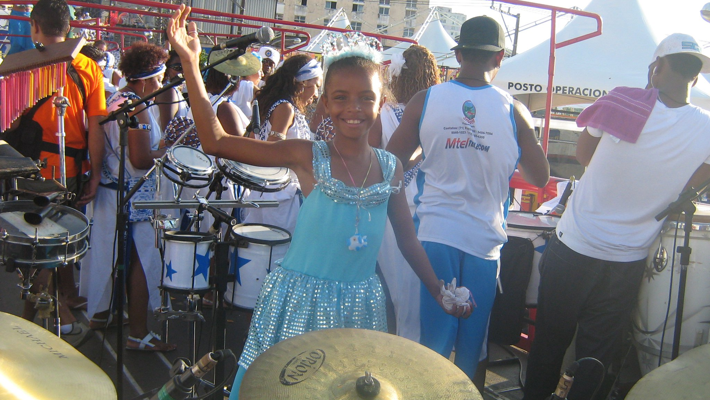
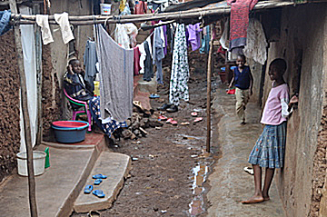
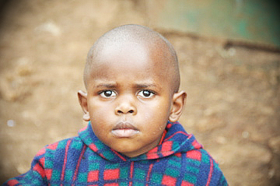

Slide 13
Those who SHINE stand on a foundation of…
Powerful, positive beliefs
Moral values
Optimistic attitudes
Never-give-up work ethics
Deep hopes for a better future

Slide 14
Action Step 3 Eliminate Ego

Slide 15
Eliminating ego means to let go of that part of us that seeks out the faults in ourselves and in others.

Slide 16
Ego is all negativity that originates from selfishness, false beliefs and fearful perceptions.

Slide 17
Action Step 4 Lighten Up and Love

Slide 18
Happy people and unhappy people tend to have had very similar life experiences. The difference is that the average unhappy person spends more than twice as much time thinking about unpleasant events in their lives, and happy people tend to SEEK and rely upon things that brighten their personal outlook.

Slide 19
A saying that hung in Mother Teresa’s office, written by Kent Keith…

Slide 20
People are often unreasonable and self-centered. Forgive them anyway. If you are kind, people may accuse you of ulterior motives. Be kind anyway. If you are honest, people may cheat you. Be honest anyway. If you find happiness, people may be jealous. Be happy anyway.

Slide 21
The good you do today may be forgotten tomorrow. Do good anyway. Give the world the best you have, and it may never be enough. Give your best anyway. For you see, in the end, it is between you and God. It never was between you and them anyway.

Slide 22
Action Step 5 Promote Peace

Slide 23
The Non-Profit Global Prosperity and Peace Initiative was launched in America in 2016.
The Initiative offers a solution for 11 of the United Nation’s 17 Sustainable Development Goals.
The Initiative will be implemented in 196 nations with a Master Action Plan (a Peace MAP).

Slide 24
The foundation of the Initiative is education - www.TotalLifeExcellence.org
The Global Prosperity and Peace Initiative will always be developing and improving - www.ProsperityandPeace.org

Slide 25
Within each one of us is the strength, the patience, and the passion to create a more loving, prosperous, and peaceful world.

Slide 26
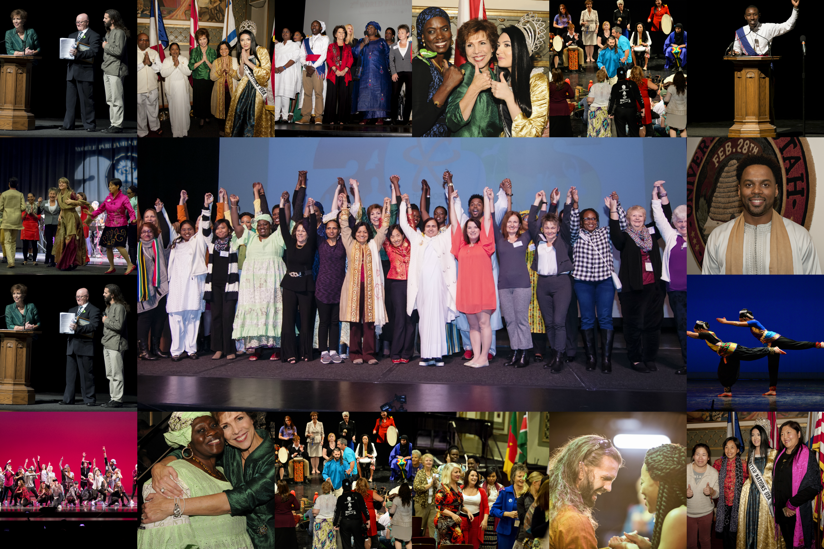
www.ProsperityandPeace.org

